Slide 1
listen …

Slide 2
GES1011/GESS1009
The Evolution of a
Global City-State

Slide 3
historiographical difference
Turnbull (Lee)
Miksic
human activity since 1819 …
sources: colonial documents
dominant since 1960s …
links Singapore to the outside (Britain)
human activity since 14th century …
sources: archaeological, literary (Sulalat) and some others (Chinese)…
emerged between mid-1980s and 1997 …
links Singapore to the outside (regional and transoceanic*)

Slide 4
a rather obvious issue/question:

Slide 5
historiographical difference
Turnbull (Lee)
Miksic
human activity since 1819 …
sources: colonial documents
dominant since 1960s …
links Singapore to the outside (Britain)
human activity since 14th century …
sources: archaeological, literary (Sulalat) and some others (Chinese)…
emerged between mid-1980s and 1997 …
links Singapore to the outside (regional and transoceanic*)

Slide 6
a rather obvious issue/question: what ‘falls’ between their periodizations?

Slide 7
Question and Response

Slide 8
exploration and emptiness …

Slide 9
recap: a more recent regional human unfolding
Singapura/Temasek a nodal trading polity in the 14th century …
following in the regional legacy of Funan and Srivijaya (among many others) …
most probably not as dominant as these two forerunners …
only lasted a century …

Slide 10
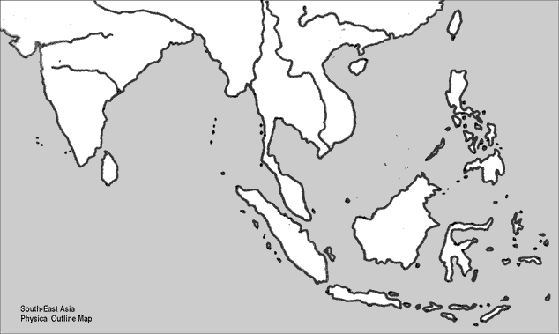
recap: trading polities

Slide 11
recap+: trading polities

Slide 12
recap+: trading polities

Slide 13
recap +: trade and religion …
Buddhism dominant in the region …
towards the end of the 13th century …
‘Islam’ begins to displace Buddhism in most of island SEA …

Slide 14
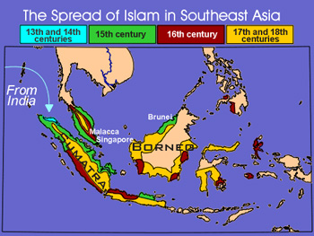
trade and religion …

Slide 15
trade and religion …
the transition from Buddhism to Islam is detectable in the Sulalat …
emphasis on ‘white’ …
white sand, white elephants, white blood …
Singa-pura … (Lion City) …
many such named polities in the region …
Sri Tri Buana, Paduka Sri Maharaja …
all the above regarded as expressions of Buddhist cosmology …

Slide 16
trade and religion …
towards the end of the geneology of Singapura’s 5 kings …
Sultan Iskandar Shah (descendant of Iskandar Zulkarnain/ Persianised Alexander the Great) …
a Persian influenced Islamic name …
Kwa’s Persian cosmopolis from 7th to 17th centuries …
‘Farsi’ the lingua franca (bridge language) of silk roads of the land and sea …

Slide 17
Question and Response

Slide 18
our task today …
the fate of what is now 1°09’N and 1°29’N, and, 103° 38’E and 104° 06’E ...
between the end of the 14th century/early 15th century …
until the eve of the arrival of Raffles in the early 19th century …

Slide 19
our task today …
decline of concentrated human activity around the Singapore river from beginning of the 15th century …
Singapura’s first (lineal ?)* successor (cf. imitators): Melaka …
the arrival of aggressive European trading concerns (Portuguese and Dutch) in the region …

Slide 20
our task today …
Singapura’s ‘second’ successor/Melaka’s successor: Johor …
the rise of other regional powers : Aceh …
the island on the eve of the arrival of Raffles in 1819 …

Slide 21
Singapura: a trading node …
Miksic’s archaeological discoveries suggest no significant human activity on the island until the late 13th/early 14th century …
and a sudden sharp decline at the end of the 14th century …
the Sulalat narrates that the last ruler of Singapura fled the island at the end of 14th century because of Siamese attacks …
and re-established further north in Melaka …

Slide 22
Singapura: a trading node …
for a long time, we have assumed that the attack of a trade rival, perhaps a jealous rival was the reason for Singapura’s demise ...
but Kwa Chong Guan, in his 2017 book, argues that the decline of Singapura may in fact be a consequence of a mini ice age that lasted from the early 14th century, peaking in the 17th century (Kwa) …
some scientists date it from 1150CE to 1850CE ...

Slide 23
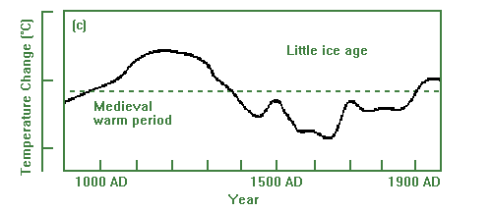
Singapura: a trading node …

Slide 24
Singapura: a trading node …
this little ice age resulted in colder winters in the Northern Hemisphere ...
it did not, climatologically, directly affect Singapura ...
but had a destabilising effect on China ...
disruption of agricultural cycles, famines and demographic contraction...
decline in trade activities ...

Slide 25
Singapura: a trading node …
being a nodal point ...
Singapura affected ...
move to look for a better spot for trade ???
Siamese attacked because they too were responding to this destabilising affect ???
we don’t know …
(for future administrators of Singapore, file this for reference)

Slide 26
Singapura: a trading node …
while we do not know the exact reasons for the significant drop in human activity …
we know it happened …
additionally, the Sulalat also portrays Singapura as the first manifestation of a trading polity …
and thereafter a prototype for a Malay (eventually Malay becomes somewhat synonymous with Muslim) trading polity …

Slide 27
Singapura: a trading node …
like Sriwijaya, a polity (thallassocracy?) plugged into sea-based trade; its economic viability tied to maritime trade …
llke Sriwijaya, a mythical center located in the vicinity of a hill (sacred?) …
like Sriwijaya, had rivals in the surrounding area, had to withstand attacks …

Slide 28
Singapura: a trading node …
while Singapura was the first manifestation of a successful trading polity in the Sulalat …
its demise led to the emergence of Melaka ...
and Melaka was simply, the GREATEST !!!

Slide 29
under the control of a Laksamana …
“of such importance and profit that it seems to me it had no equal in the world”
Tome Pires (writer of Suma Oriental)

Slide 30
Question and Response

Slide 31
under the control of a Laksamana …
Melaka founded at the turn of 15th century …
and like Singapura, lasted about a hundred years …
(Singapura lasted a century, Melaka lasted a century, Republic of Singapore is 56+ years old; hmmm …)
name of first ruler: Parameswara/Iskandar Shah?
hyper-successful, agile, mobile, sea-oriented mercantile polity …

Slide 32
under the control of a Laksamana …
100-200,000 residents; cosmopolitan* make-up (84 languages heard in a day) …
unlike ancient empires in being suspicious toward foreigners and dread of polluting foreign contact …
(is 2022 Singapore cosmopolitan?)

Slide 33
under the control of a Laksamana …
reasons for success:
role of Chinese protection?
maritime protection (alliances with orang laut)?
a judicious regime that facilitated fair play in trade by enforcement of a common code of moral values, perhaps even a system of law?
qualities of fairness and justice (linked to Islam?) ….
but note how Buddhism had previously adaptively provided a similar trade impetus …

Slide 34
under the control of a Laksamana …
innovative trading policy?
low custom duties during reign of Mansur Shah (1458-77) …
none on food …
3-6% depending of provenance of sea vessel …
very low compared to rivals like Ayuthia (22.2%), Bengal (37%),Pegu (12%)

Slide 35
under the control of a Laksamana …
ruler sacrificing income …
“quite modern” economic practice (Thomasz) …
preceding Enlightenment/modern economic theory in Europe …
INNOVATION!!!

Slide 36
under the control of a Laksamana …
Melaka led by a man of prowess (and often one who claimed to be a descendant of Sri Tri Buana) …
had an administration with the wherewithal to establish and manage a maritime trading center/entrepot …
apex administration of four(4): Bendahara, Penghulu Bendahari, Temmengung, Laksamana …

Slide 37
under the control of a Laksamana …
Bendahara … chief minister?
Penghulu Bendahari … controller of state revenue (treasurer?)
Temmengung … internal security; bendahara designate (police chief?)
Laksamana … military administrator (naval head?)

Slide 38
under the control of a Laksamana …
Laksamana (as naval head)…
apparently had control over islands south of the peninsula, including ‘Singapore’ …
home to Melaka’s de facto naval force …
Orang Laut ...
loyal Sea nomads …

Slide 39
under the control of a Laksamana …
like Singapura, Melaka also unravels due to the appearance of tyranny …
falls to the Portuguese; 24 August 1511 …

Slide 40
Question and Response

Slide 41
early Europeans …
while island SEA was a nodal point of East-West trade …
Western trade was mainly in the hands of Persians, Indians and the occasional European (Venetian) …
the late 15th century saw a marked increase in the presence of the Portuguese in this trading area …
marking the beginnings of what is oft-called an
Age of Exploration* ...
European Age of Exploration …

Slide 42
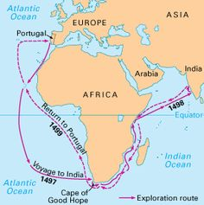
early Europeans …

Slide 43
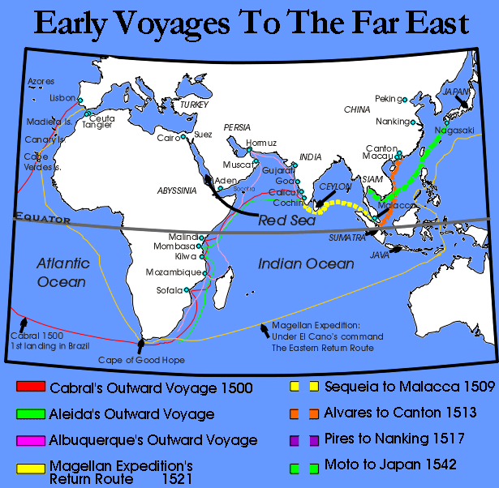
early Europeans …

Slide 44
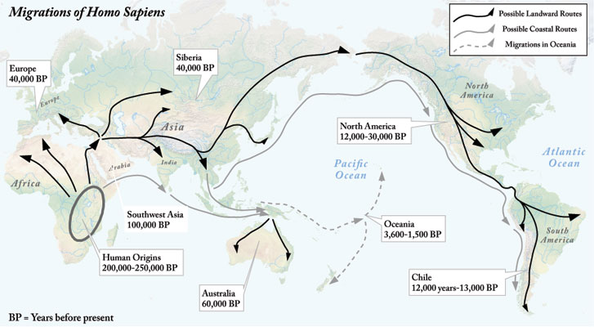
exploration/discovery ???

Slide 45
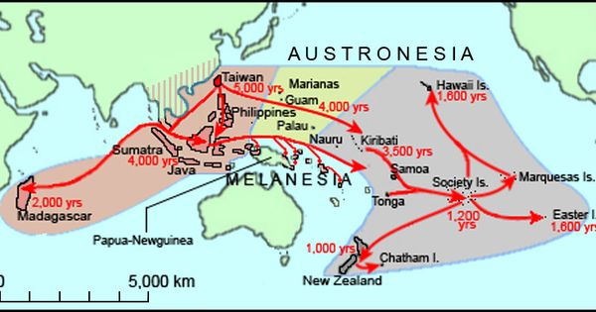
exploration/discovery ???

Slide 46
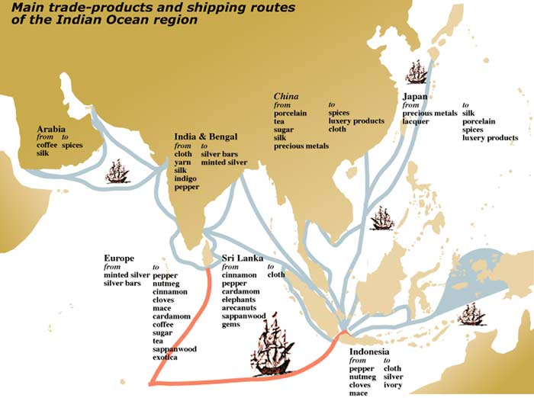
early Europeans …

Slide 47
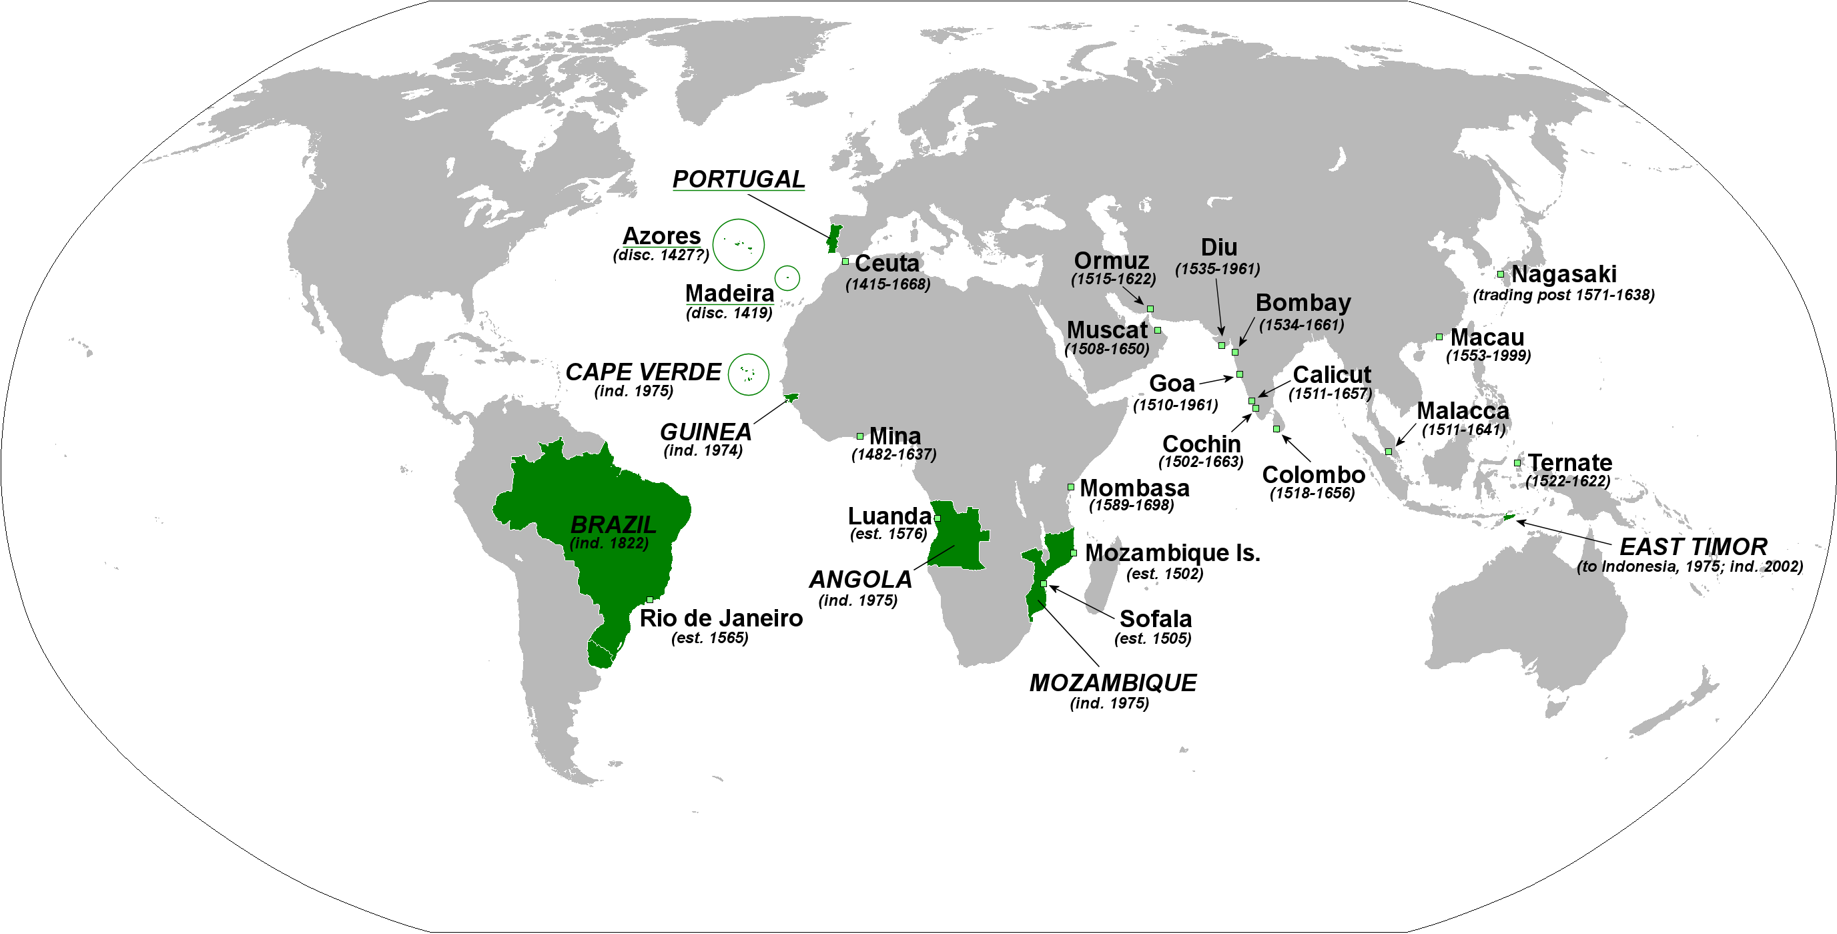
early Europeans …

Slide 48
early Europeans …
Portugese wanted a monopoly of the spice trade …
and were willing aggressively assert control …
using a mid-15th century invention, Caravel …
an agile, easier to maneuver sailing vessel
extending to colonising trading ports ..
like Melaka …

Slide 49
early Europeans …
Portugese sacking of Melaka …
made Melaka’s rulers run and reconstitute themselves in Johor …

Slide 51
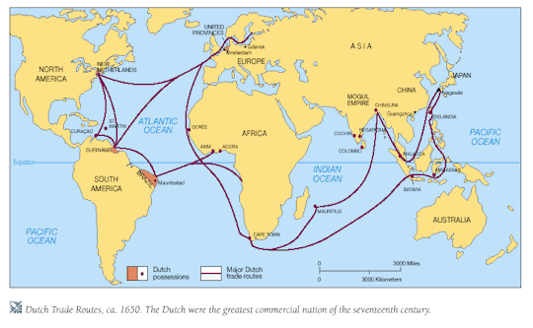
VOC/Dutch exploration and colonisation …

Slide 52
Johor …
Dutch facilitated Johor’s reemergence as patron (of Malay culture) in the area …
Dutch mediated Johor-Aceh treaty in 1641
Johor quite established as pre-eminent power in the straits by last quarter of 17th CE …
eventually overtaken by Dutch ...
EIC/English (1819 – 1942; 1945 -1963)

Slide 53
Question and Response

Slide 54
Singapura an island in a contested realm …
after its fall at the end of the 14th century ...
Singapore’s fortunes came under the auspices of the Laksamana(s) of Melaka, then Johor ...
there is now evidence that Johor trade operated partly out of an outpost led by a Shahbandar at the Kallang river mouth ...
while there is limited archaeological evidence, there is cartographical evidence ...

Slide 55
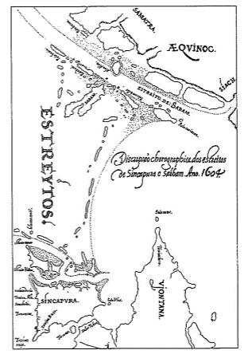
Singapura an island in a contested realm …

Slide 57
Singapura an island in a contested realm …
given trade rivalry between regional powers and European entrants ...
there is European archival evidence that both the Portuguese and Dutch had discussed plans to build fortifications on ‘Singapura’ to help assert their dominance ...
NONE of these plans ever came to fruition ...

Slide 58
Singapura an island in a contested realm …
leaving Singapura under the control of Melaka and then Johor ...
and never wholly bereft of human activity since its 14th century heyday ...
one succeeding ruler of Johor actually offered the island to an early British country (private) trader in the early 1700s ...

Slide 59
Singapura an island in a contested realm …
but the degree of limited activity declined further ...
with Dutch ascendency in the late 18th century ...
pushing trade activity southward, centred on Batavia and the Sunda Straits ...

Slide 60
VOC/Dutch …

Slide 61
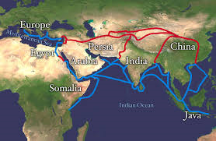
VOC/Dutch addition to older silk roads …

Slide 62
Singapura an island in a contested realm …
so while Singapura did not become a ‘sleepy fishing village’ immediately after its sharp decline at the end of the 14th century ...
by the second half of the 18th century ...
things were quieter …
Temenggong’s residence since around 1800 …
Chinese gambier planters ….

Slide 63
Singapura an island in a contested realm* …
so, a relative emptiness did descend on the island ...
in the wake of European exploration (and eventual domination*) ...

Slide 64
Question and Response

Slide 65
Tutorial 2
in Weeks 5 and 6 …
fieldtrip …
requires being away from campus …

Slide 66
Tutorial 2
meet at Keramat/Makam Iskandar on Fort Canning …
look out for map and fieldtrip guide (workbin named Tutorial 2) ...

Slide 67
Tutorial 2
if it rains …
bring an umbrella/raincoat …
if it rains very heavily …
meet at museum entrance …

Slide 68
Question and Response

